Slide 1
Army of Jesus
WHEEL WING MEETING
Goa – Rajasthan
PRAISE REPORT

Slide 2
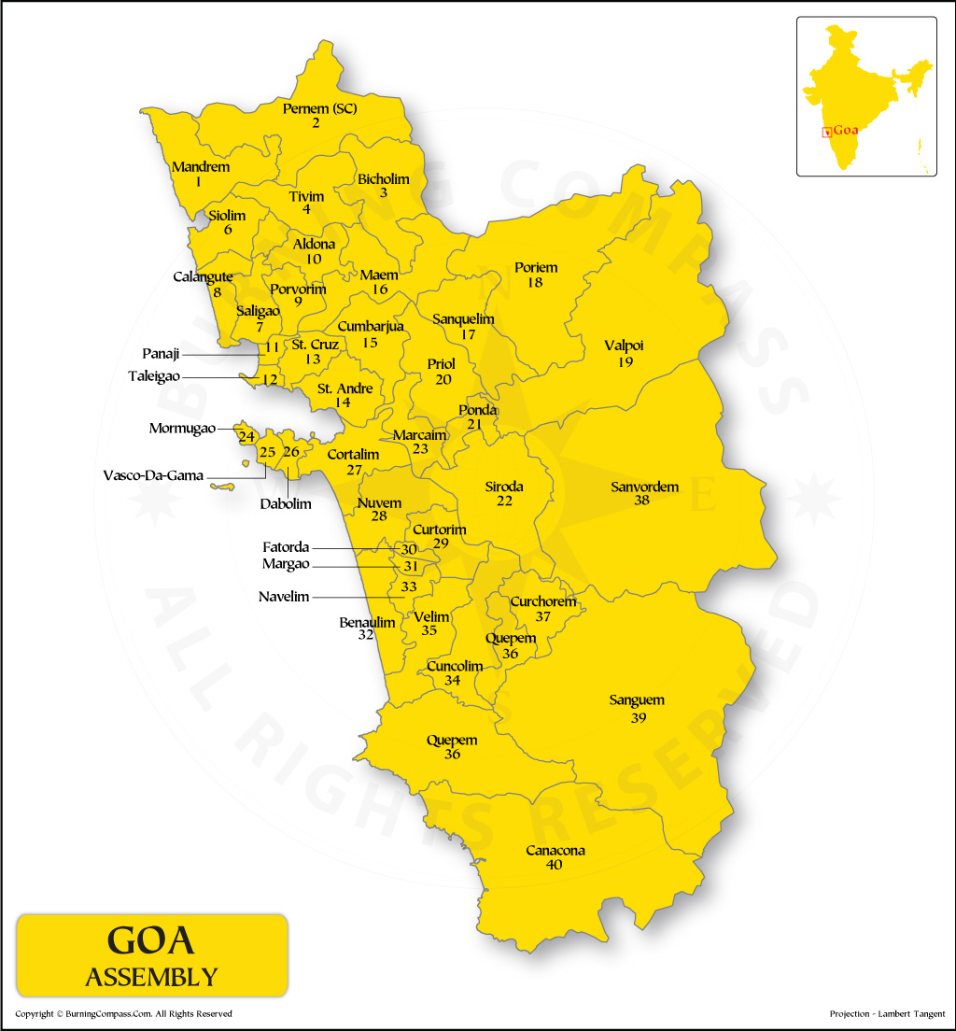

Slide 3
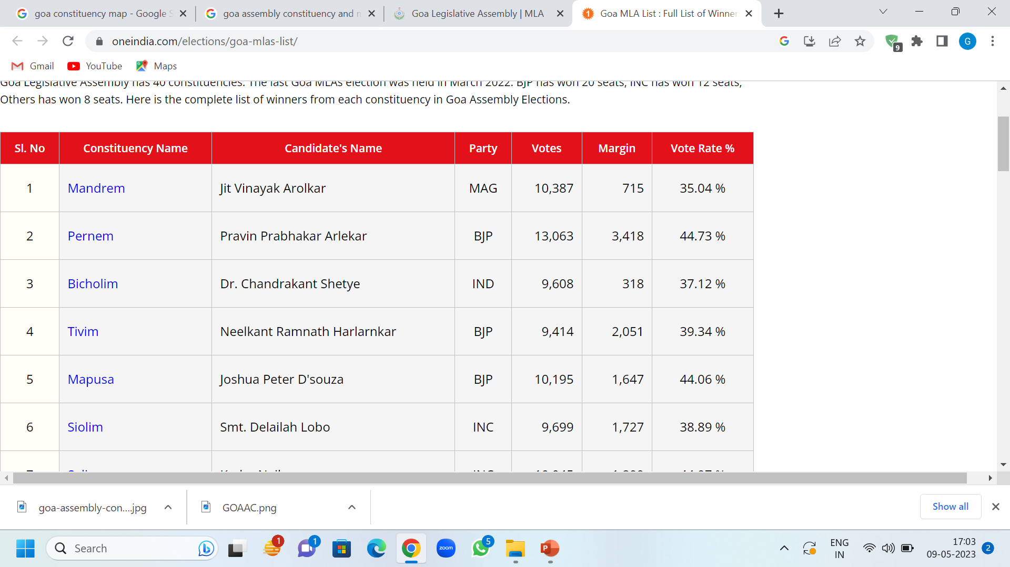
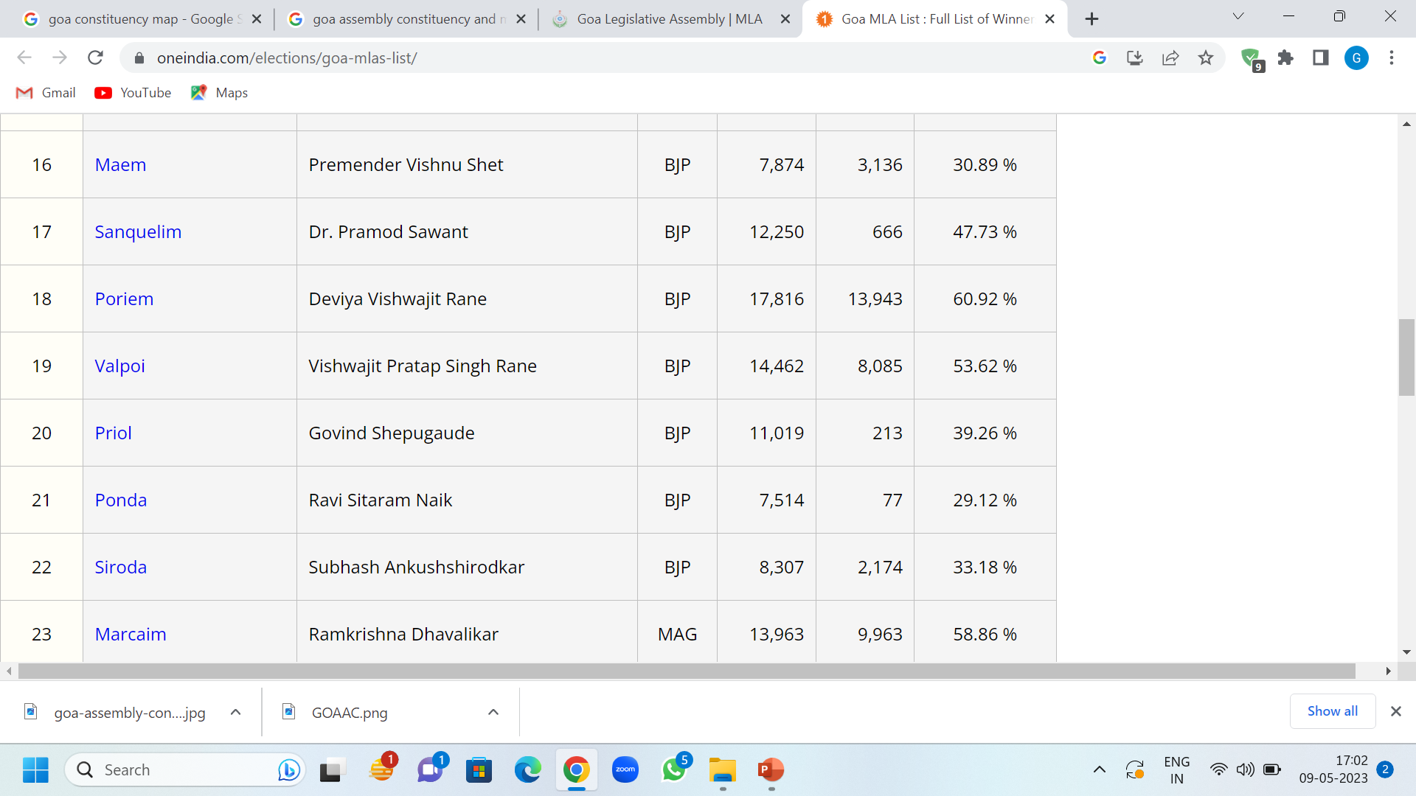
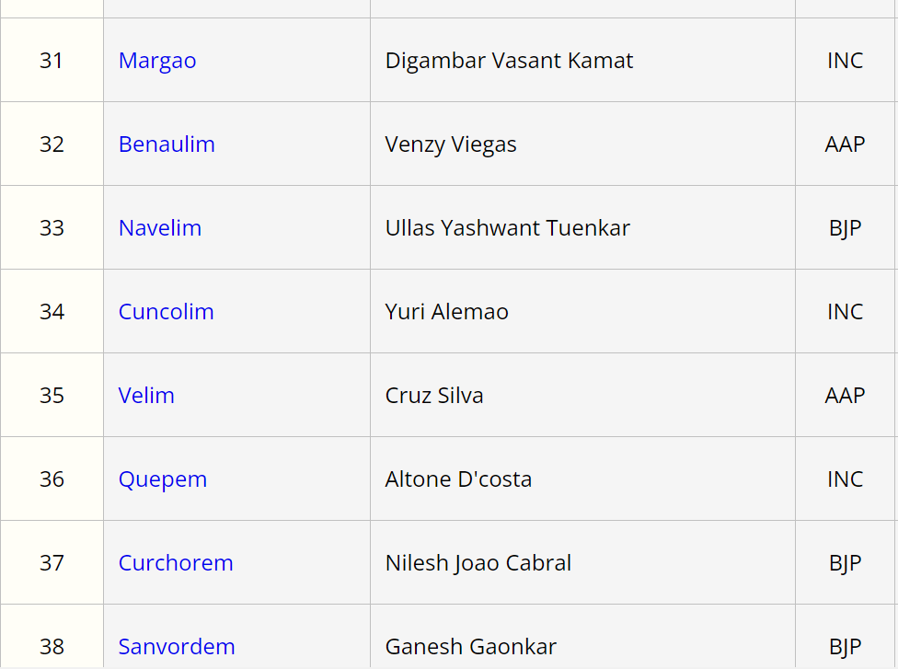
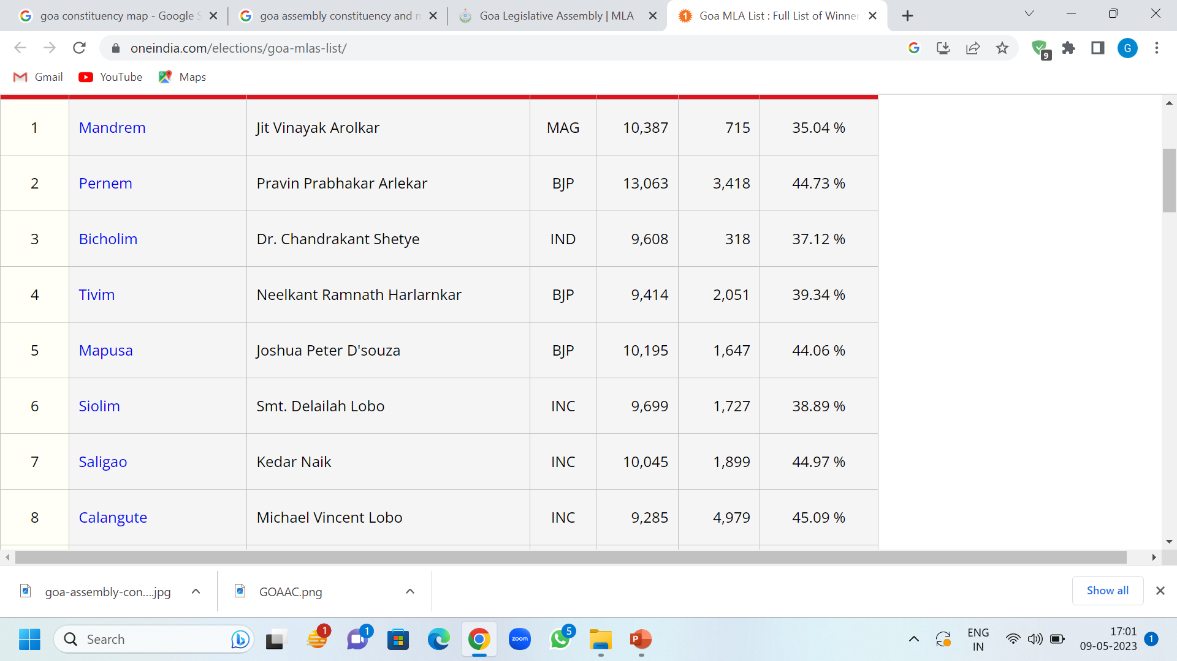
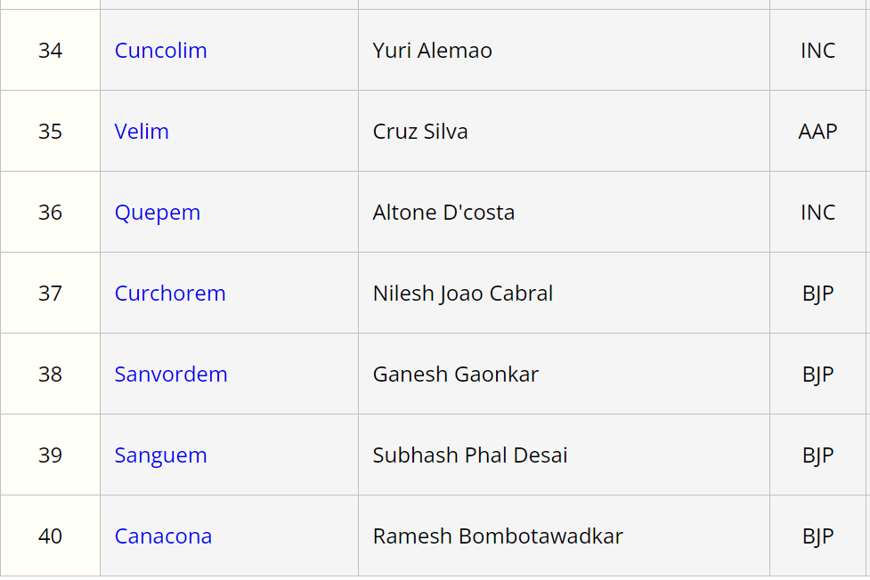
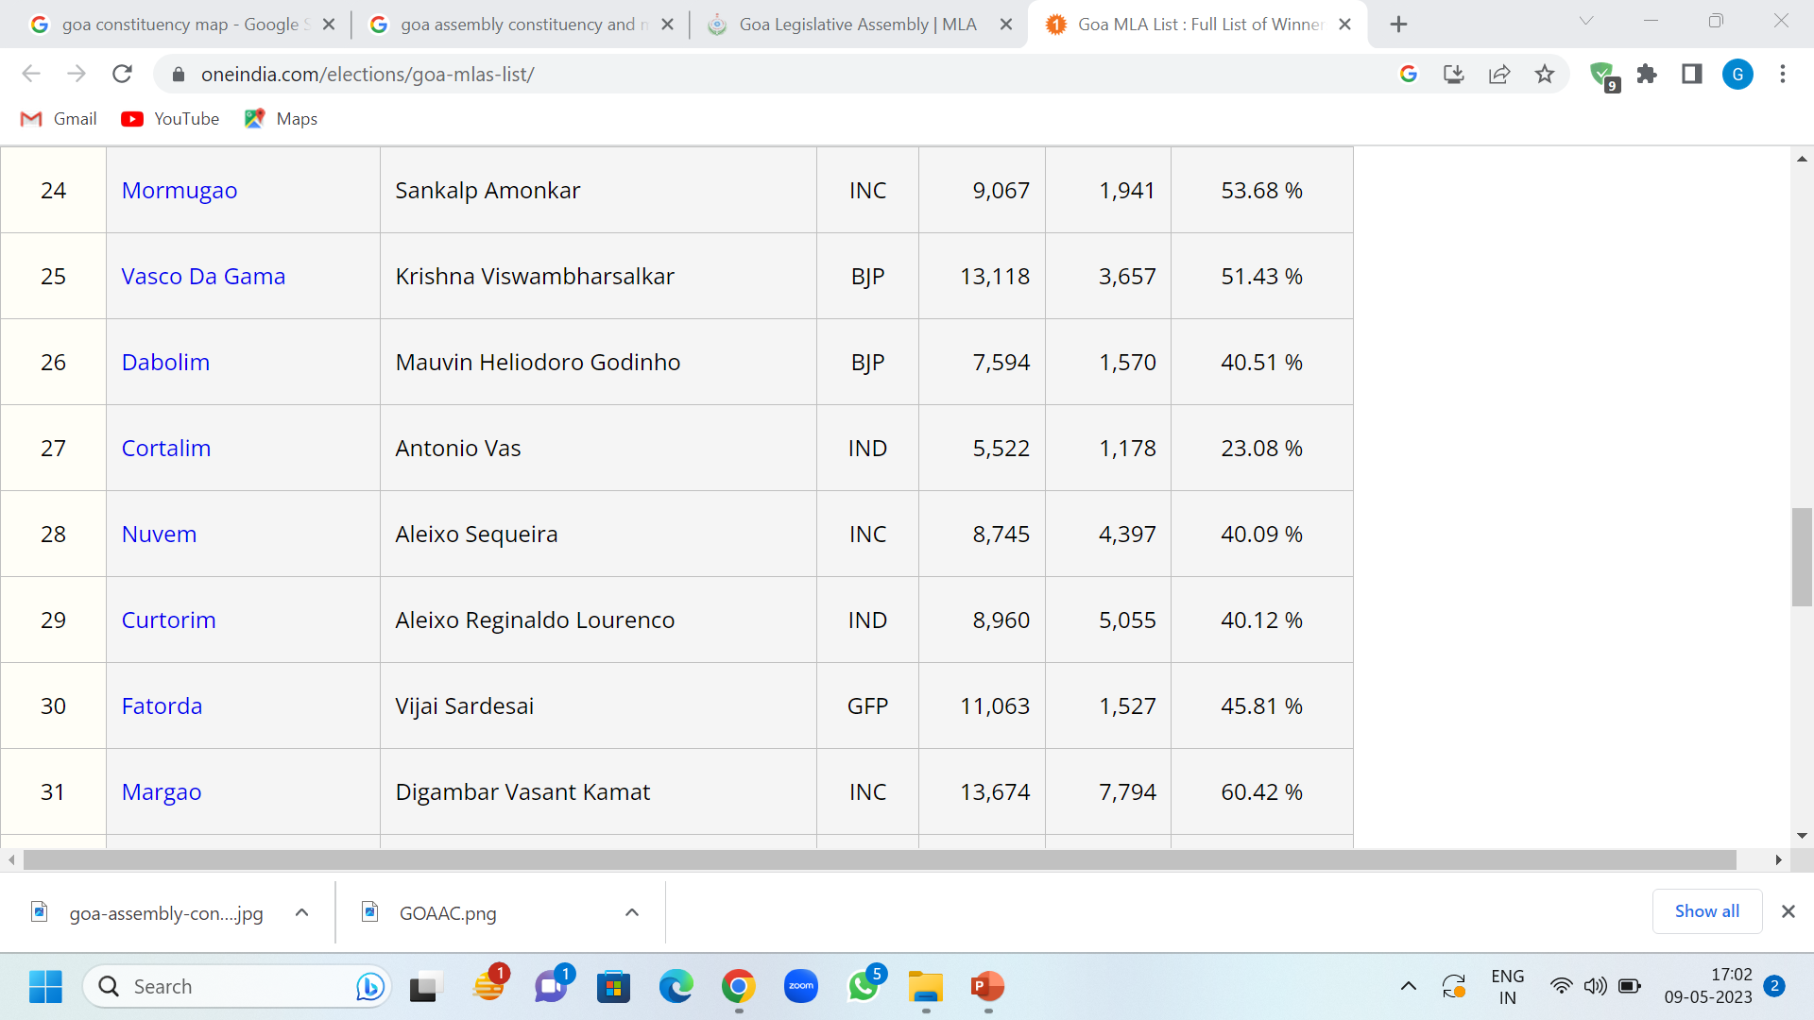
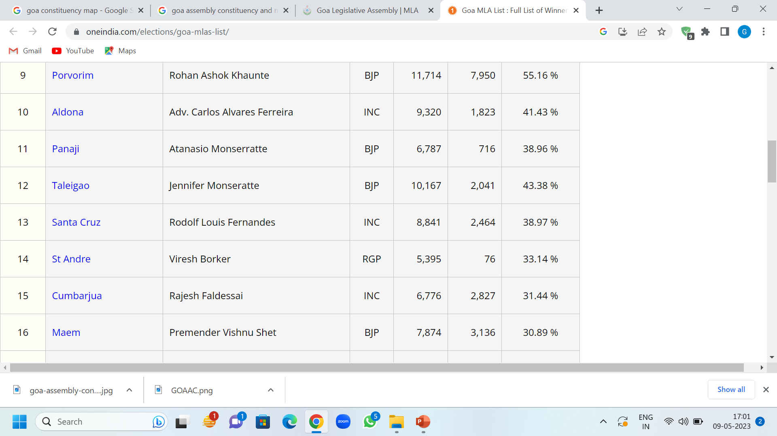
Number of Legislative Constituencies = 40
Parliamentary Constituencies = 02

Slide 4
Name | Shadow Parli Members
1. Francis | Aldona and Mapusa
2. Priyanka | Bicholim and Mayem
3. Arvind | Santa Cruz and Panjim
4. Gerardo | Siolim and Calangute
5. Flory | Pernem and Tivim
6. Helen | Mandrem and Saligao
7. Nitin | Cortalim and Cumbarjua
8. Mario | Vasco da Gama and Mormugao
9. Fatima | Nuvem and Sant Andre
10. Patsy | Margao and Fatorda
11. Joseph | Benaulim and Quepem
12. Shankar | Ponda and Marcaim
13. Sejal 14. Seema | Shiroda and Dabolim Curchorem and Porvorim
15. Sunanda | Priol and Quepem
16. Sairam | Cuncolim and Velim
17. Shanta 18. Juliet 19. Sumitra 20. Madhavi | Canacona and Taleigao Navelim and Sanvordem Valpoi and Poriem Curtorim and Sanquelim

Slide 5
Panjim City is facing the ire of people who are facing terrible inconvenience bec of roadworks. Almost every road was dug up. Recently a water pipeline broke at Ines area.
There are a series of incidents where water pipelines were damaged while carrying out Smart city's works. The issue is now being addressed.
The contractor failed to complete the Smart city works by 31st May.

Slide 6
In the constituency of Aldona.
High Tension electrical cabling underground is taken up for the entire constituency.
Praise God
Work order placed for 125 crores

Slide 7
The painting of Corjuem-Aldona bridge that was pending for couple of years is now taken up. Estimated cost Rs 36 laks. Praise God!

Slide 8
Low Tension underground electrical cabling work is taken up in Mapusa constituency.
At a cost of Rs 75 lakhs
Praise God!

Slide 9
Hot mixing of the road leading to world famous Friday Mapusa market will be undertaken after monsoon ends.
Praise God

Slide 10
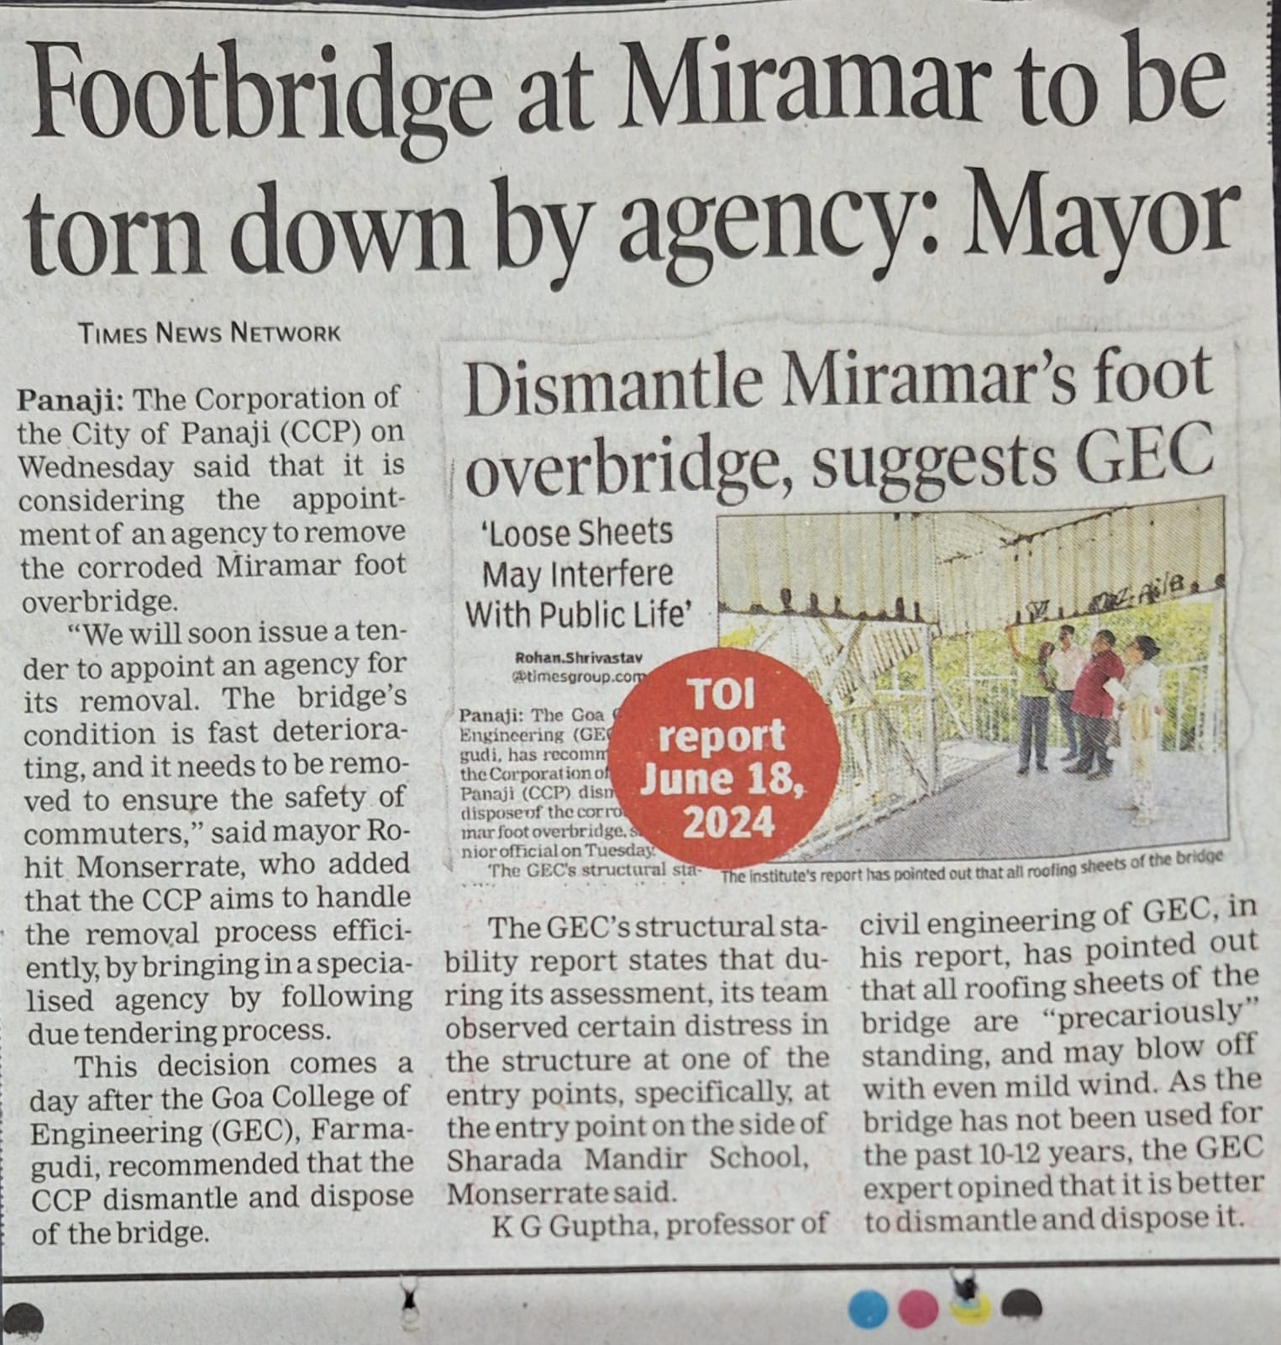
This Foot bridge at Miramar was built 10-12 years ago to provide safe access to the Sharada Mandir School children, to avoid crossing the road. But reportedly it was never used.
Every time I went for an evening walk along with my wife, and pas by, I used to look at this bridge, pray and prophesy in Jesus name that it be removed safely. Because it looked precarious. It was corroded.
Soon there was this TOI report the (CCP) Corporation of City of Panaji saying, it is considering the appointment of agency to remove the corroded Miramar foot bridge and that they will soon issue a tender to appoint an for its removal, to ensure safety of commuters. Amen
Glory be to God!

Slide 11
PLANNING – NEXT SIX MONTHS
Morning Worship – 6.00 am to 7.30 am. All are welcome!
Every Saturday Night Worship – 9.30 pm –
Proposed Gifts Schools to conducted:
- Gift of Healing – David School of Worship -
- Family Building – JSP School of Prophecy –
- Level 1 & 2
- Paul School of Deliverance – Level 1 –
- Forgiveness and Reconciliation – Level 1
- Felowship Meet.

